Slide 1



F# Code I Love
Don Syme, F# Community Contributor
Researcher @ Microsoft

Slide 2
A stroll through some of the F# code I love… …and some that I love a little less :) …and how this relates to the language features

Slide 3
Aside The Early History of F# - HOPL IV submission (2020) Draft now available! fsharp.org/history

Slide 4
WARNING: Opinion!

Slide 5
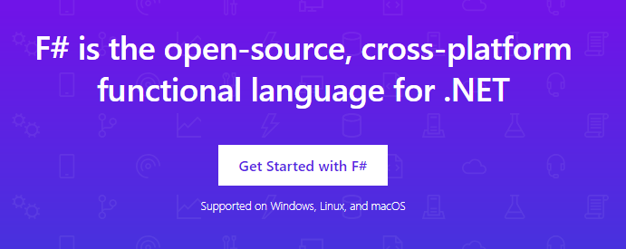
www.microsoft.com/net/

Slide 6
TL;DR – Where we are now
F# is open, cross-platform, neutral, independent
The F# Compiler Service powers many other tools
F# 4.1 now complete!
Debian, RPM and .NET Core for Linux/OSX
All F# language and tooling is accepting contributions
Fable for F#-to-Javascript
SAFE for F# fullstack
The F# community is self-empowered
fsharp.org
The Visual F# Tools are Microsoft’s professional tools for Windows and Azure
Xamarin provide F# tools Android and iOS

Slide 7
The F# Language Design Process github.com/fsharp/fslang-design github.com/fsharp/fslang-suggestions

Slide 8
F# 4.0 ✔ True shift to cross-platform open engineering ✔ Long laundry list of language items ✔ Normalized core library ✔ Type providers more powerful ✔ Better debugging, tooling, performance ✔ ~20% compiler perf improvement
https://github.com/fsharp/fslang-design/tree/master/FSharp-4.0

Slide 9
F# 4.1 ✔ Optional large scope cycles more on this later) ✔ Result<T,Error> in standard library ✔ Unboxed (struct) tuples ✔ Unboxed (struct) records ✔ Unboxed (struct) unions ✔ More bits and pieces
https://github.com/fsharp/fslang-design/tree/master/FSharp-4.1

Slide 10
F# 4.5 ✔ Span<T> high perf type-safe non-allocating code ✔ Improved async debugging ✔ More bits and pieces
https://github.com/fsharp/fslang-design/tree/master/FSharp-4.5

Slide 11
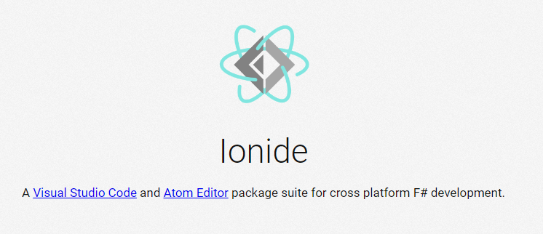
VSCode + Ionide = Cross-Platform F# Editing Love

Slide 12
F# and .NET Core (Linux, OSX, Windows) dotnet new -lang F# dotnet build docs.microsoft.com/dotnet/core/

Slide 13
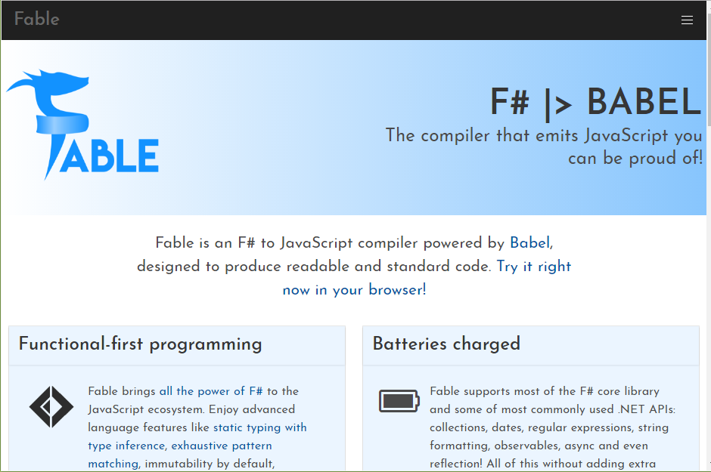

Slide 14
A functional-first approach makes a huge difference in practice fsharp.org/testimonials

Slide 15
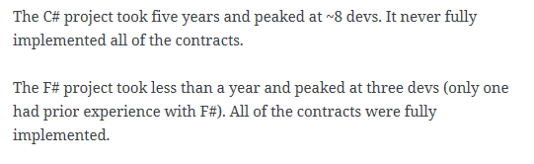
An analysis (Simon Cousins, Energy Sector)
350,000
lines of C# OO
by offshore team
30,000
lines of robust F#, with
parallel +more features
An application to evaluate the revenue due from Balancing Services contracts in the UK energy industry
http://simontcousins.azurewebsites.net/does-the-language-you-use-make-a-difference-revisited/

Slide 16
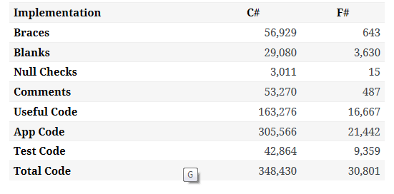

Slide 17
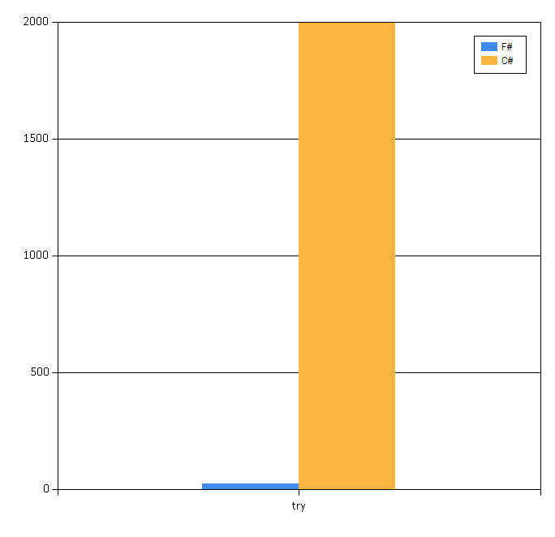

Slide 18
Simon Cousins, Energy Sector
Zero
bugs in deployed system
“F# is the safe choice for this project,
any other choice is too risky”
An application to evaluate the revenue due from Balancing Services contracts in the UK energy industry
http://simontcousins.azurewebsites.net/does-the-language-you-use-make-a-difference-revisited/

Slide 19


A $3B Unicorn, Built on F#

Slide 20
Back to the talk…

Slide 21
OK, I’m the language designer. I could tell you about the features. But what code do I like and not like?

Slide 22
Reminder: The F# Advent Calendar (started by F# users in Japan!) English 2017, 2016, 2015 Japanese 2016, 2015, 2014, 2013, 2012, 2011, 2010

Slide 23
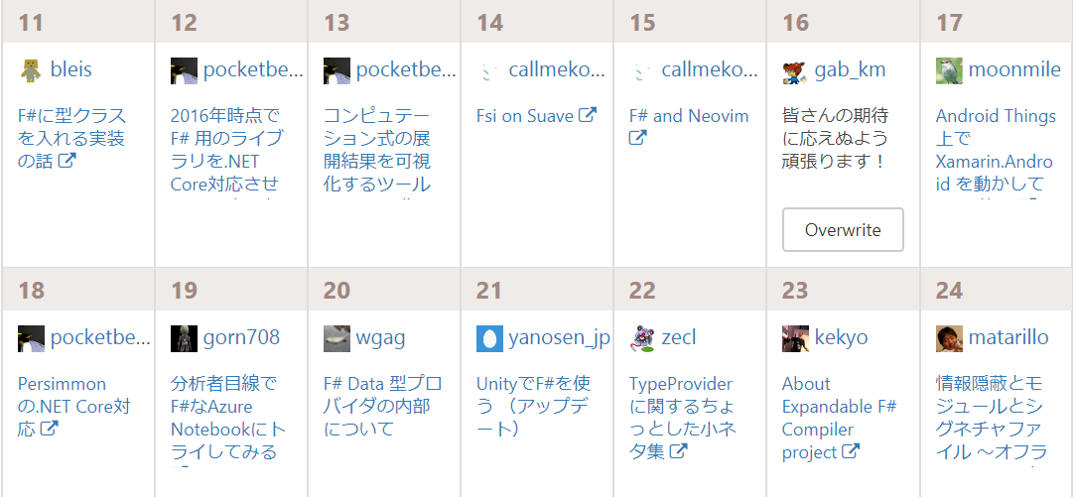
Reminder: The F# Advent Calendar (started by F# users in Japan!) English 2017, 2016, 2015 Japanese 2016, 2015, 2014, 2013, 2012, 2011, 2010

Slide 24
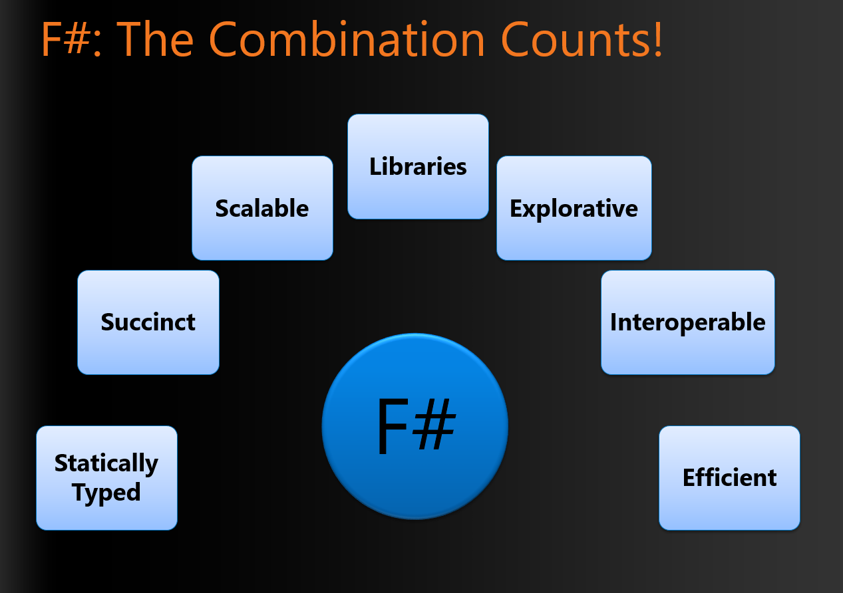
Foundations of the F# Design (~2007)

Slide 25
From that, it’s fair to say that I love these :) Code that is succinct Code that is expressive Code that interoperates Code that is performant Code that is accurate Code that is well-tooled

Slide 26
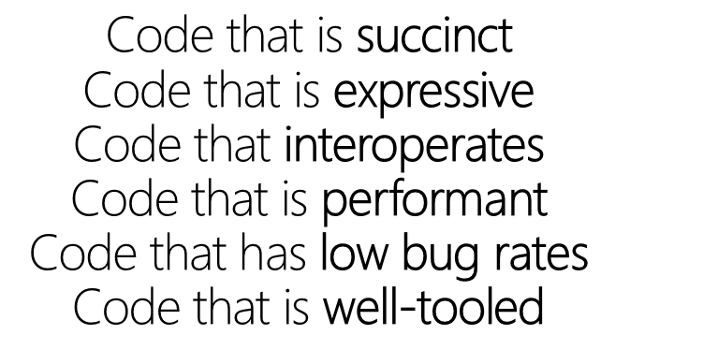
Code I love!
printfn "hello world"
✓
✓
✓
✓
✓
✓

Slide 27
Code I love! - pipelines
x |> f1
x |> f1 |> f2 |> f3 |> …..

Slide 28
Code I love! - pipelines
let symbolUses =
symbolUses
|> Array.filter (fun symbolUse -> …)
|> Array.Parallel.map (fun symbolUse -> …)
|> Array.filter (fun … -> …)
|> Array.groupBy (fun … -> …)
|> Array.map (fun … ->….)

Slide 29
Code I love! - pipelines - domain modelling

Slide 30
Code I love! - pipelines - domain modelling
/// Represents a parsed expression
type Expr =
| True
| And of Expr * Expr
| Nand of Expr * Expr
| Or of Expr * Expr
| Xor of Expr * Expr
| Not of Expr
+ recursion, evaluation, normalization, analysis, visualization, …

Slide 31
Code I love! - pipelines - domain modelling
/// Represents information known about a value
type ExprValueInfo =
| UnknownValue
| ValValue of ValRef * ExprValueInfo
| TupleValue of ExprValueInfo[]
| RecdValue of TyconRef * ExprValueInfo[]
| UnionCaseValue of UnionCaseRef * ExprValueInfo[]
| ConstValue of Const * TType
| CurriedLambdaValue of Unique * Expr * TType

Slide 32
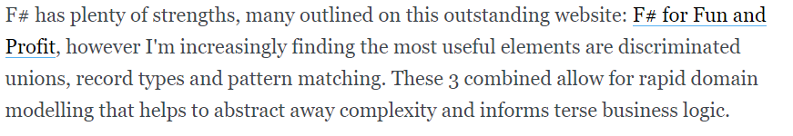
Code we love :) - pipelines - domain modelling
type Status =
| Online
| Unresponsive of string
| Missing of string
| NotChecked of string
| Ignored
https://lukemerrett.com/fsharp-domain-modelling/

Slide 33

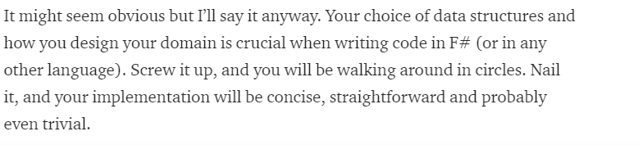
Code we love :) - pipelines - domain modelling
https://medium.com/@odytrice
Ody Mbegbu
type Value = | Integer of int64 | String of string | Date of DateTime | Data of string | Bool of bool | Dict of list<string * Value> | Array of list<Value>

Slide 34
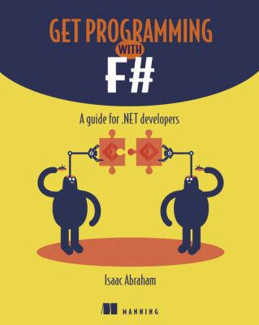
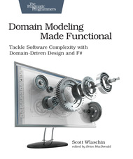
Code we love :) - pipelines - domain modelling - domain semantics

Slide 35
Code I love :) - reactive, functional UIs - view functions!
A functional-reactive dynamic web view
/// The view function giving updated content for the page
let view model dispatch =
match model.Text with
| [| |] ->
div [] [ div [] [str "Loading..."] ]
| _ ->
div [ ClassName "container" ] [
button [ OnClick (fun _ -> dispatch Faster) ] [ str "Faster" ]
div [ ClassName "theText" ] [ str model.Text.[model.Index] ]
button [ OnClick (fun _ -> dispatch Slower) ] [ str "Slower" ]
div [] [ str (sprintf "Ticks Per Update: %d" model.TicksPerUpdate) ]
]

Slide 36
Code I love :) - reactive, functional UIs - view functions!
A functional-reactive mobile app view
/// The view function giving updated content for the page
let view (model: Model) dispatch =
if model.Pressed then
Xaml.Label(text="I was pressed!")
else
Xaml.Button(text="Press Me!", command=(fun () -> dispatch Pressed))

Slide 37
Code I love :) - reactive, functional UIs - view functions!
github.com/fsprojects/Fabulous

Slide 38
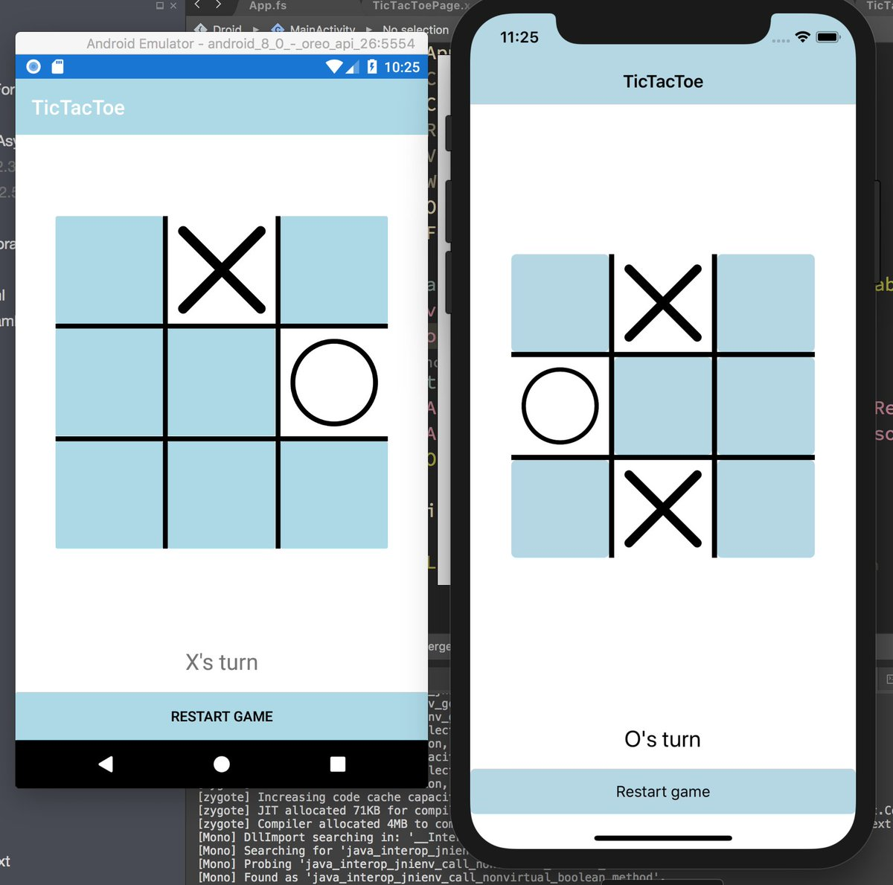
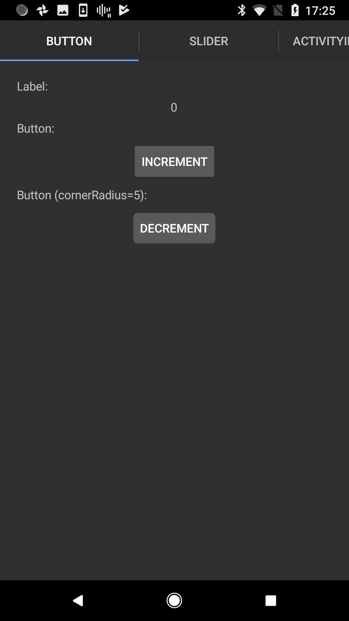
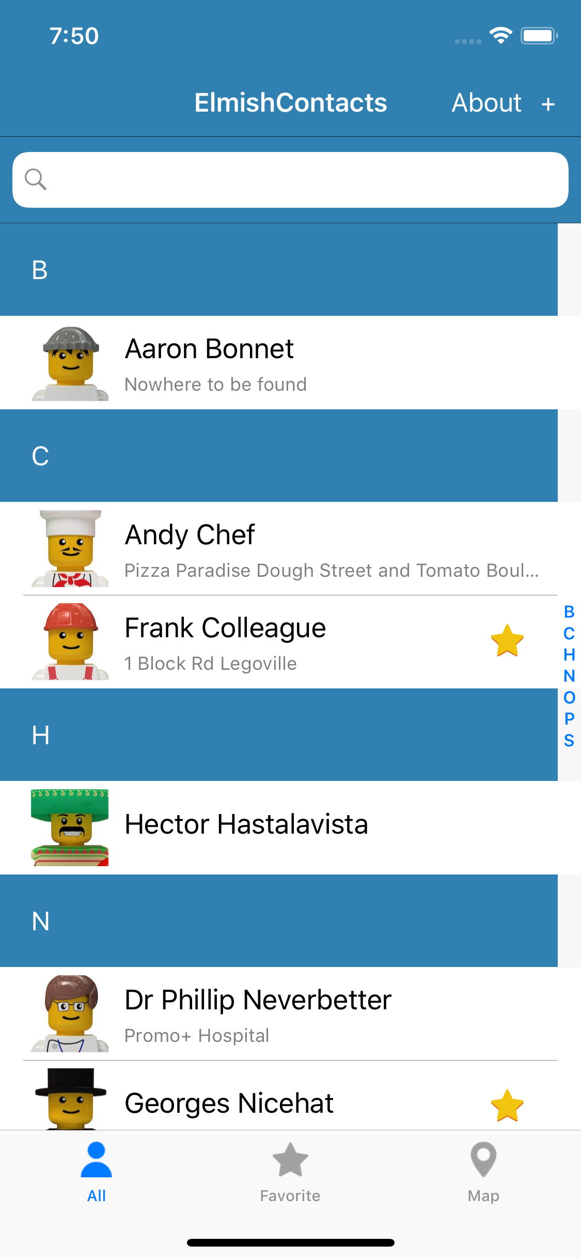
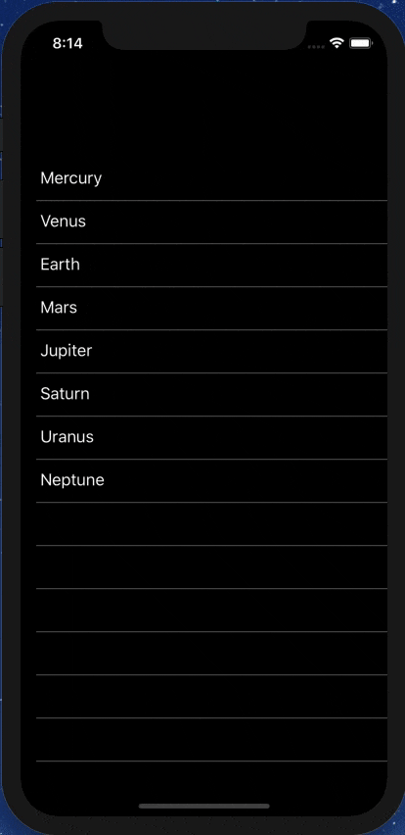
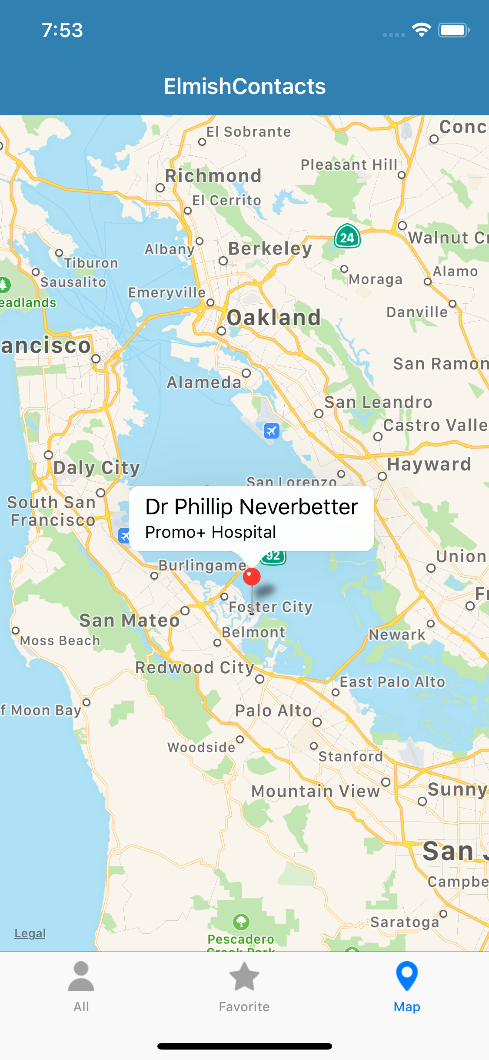



Slide 39
Code I love :) - data scripting
// Get the nuget stats schema
type NugetStats = HtmlProvider<"https://www.nuget.org/packages/FSharp.Data">
// Load the live package stats for FSharp.Data
let rawStats = NugetStats().Tables.``Version History``
// Group by minor version and calculate download count
let stats =
rawStats.Rows
|> Seq.groupBy (fun r -> getMinorVersion r.MinorVersion)
|> Seq.sortBy fst
|> Seq.map (fun (k, xs) -> k, xs |> Seq.sumBy (fun x -> x.Downloads))

Slide 40
Code I love :) - scripted tests Ctrl-A, Alt-Enter and you can start debugging and developing individual tests
Note, I don’t like [<TestData(…)>] because it doesn’t work well with F# scripting
#if INTERACTIVE
#r "../../debug/net45/SomeComponent.dll"
#r "../../packages/NUnit.3.5.0/lib/net45/nunit.framework.dll"
#load "Common.fs"
#else
module Tests.MyTests
#endif
open System
open NUnit.Framework
[<Test>]
let ``Test project1 whole project errors`` () =
let abc = ..
let def = ..
..
[<Test>]
let ``Test Project1 should have protected FullName`` () = ..
[<Test>]
let ``Test project1 should not throw exceptions`` () = ..
https://github.com/Microsoft/visualfsharp/blob/master/tests/service/ProjectAnalysisTests.fs

Slide 41

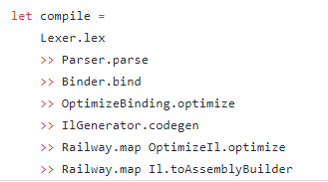
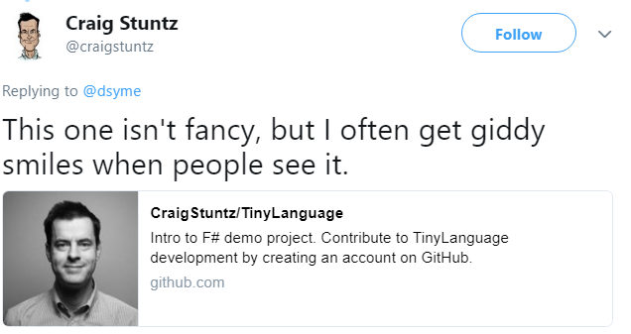
Code we love :) - composition

Slide 42
http://fsharp.github.io/FSharp.Data/images/csv.gif http://fsharp.github.io/FSharp.Data/images/wb.gif
Code we love :) - type providers

Slide 43
But not all Functional Code is Good Code

Slide 44
curry, uncurry
nooo
curry String.Compare s1 s2
yes
String.Compare (s1, s2)
let curry f x y = f (x,y)
let uncurry f (x,y) = f x y
nooo
let ZipMap f a b =
Seq.zip a b
|> Seq.map (uncurry f)
Too indecipherable, too often
let ZipMap f a b =
Seq.zip a b
|> Seq.map (fun (x,y) -> f x y)
yes

Slide 45
<|
let testString = "Happy"
let amendedString =
testString
|> replace "H" "Cr"
|> joinWith <| "birthday"
nooo
let (<|) f x = f x
Please, never, ever use the <| operator in beginner code
let testString = "Happy"
let amendedString =
testString
|> replace "H" "Cr"
|> joinWith "birthday"
yes
Please, don’t ever put |> and <| on the same line :)

Slide 46
<||, <|||
nooo
let (<||) f x y = f x y
let (<|||) f x y z = f x y z
Please, always avoid the <|| and <||| operators. They should be deprecated

Slide 47
Point-free is not a virtue
nooo
“Point free” is code without explicit lambdas or let
Often heavy use of “>>”, “>>=“, “curry”, “uncurry”, partial application
Using and combining existing functions as values is OK
Please give explicit arguments to functions defined in modules
Please, avoid needless over-use of point-free code
let add10To x = x + 10
let doubleAndIncr x = x * 2 + 1
yes
“In rare cases there can even be point-free DSLs that are actually legible in the large. However the utility of adopting this approach always carries a big burden of proof, and should not be motivated merely out of stylistic considerations.” Eirik Tsarpalis

Slide 48
Fold considered harmful
Please, avoid needless use of fold in code if simpler alternatives are available
List/Seq/Array.sumBy
List/Seq/Array.maxBy
List/Seq/Array.choose
List/Seq/Array.tryPick
List/Seq/Array.mapFold
List/Seq/Array.reduce
….
“Data.fold” is a blunt instrument
Replace by something more simpler
Sometimes harder to understand than an imperative while loop
If you fold or mapFold, use ||>
✗
List.fold (fun state x -> new-state) state0 xs
v.
✓
(state0, xs) ||> List.fold (fun state x -> new-state)

Slide 49
Records can be bad
If your record types are not symmetric or representationally simple, then use a class
Each time we design a type, we design the external view of the type, and the internal representation.
A record is great when these are the same. Beware records when they are not.
Be prepared to make records private or convert records to classes. Can be painful.
✗
type Program =
{ initial : int
labelToNode : Map<int, string> ref
nodeToLabel : Map<string, int> ref
transitionCount : int ref
variables : Set<string> ref
... }
+ 10 files that hack on this data structure
type Program (parameters) =
let mutable initial = -1
let mutable labelToNode = Map.empty
let mutable nodeToLabel = Map.empty
let mutable nodeCount = 1
let mutable transitionCount = 0
let mutable transitionsArray = …
let mutable activeTransitions = Set.empty
let mutable variables = Set.empty
...
✓
v.

Slide 50
Objects Good, Objects Bad

Slide 51
F# - Objects + Functional
type Vector2D (dx:double, dy:double) =
let d2 = dx*dx+dy*dy
member v.DX = dx
member v.DY = dy
member v.Length = sqrt d2
member v.Scale(k) = Vector2D (dx*k, dy*k)
Inputs to object
construction
Object internals
Exported properties
Exported method

Slide 52
Objects
Constructed Class Types
type ObjectType(args) =
let internalValue = expr
let internalFunction args = expr
let mutable internalState = expr
member x.Prop1 = expr
member x.Meth2 args = expr
Object Expressions
{ new IObject with
member x.Prop1 = expr
member x.Meth1 args = expr }
{ new Object() with
member x.Prop1 = expr
interface IObject with
member x.Meth1 args = expr
interface IWidget with
member x.Meth1 args = expr }
Object Interface Types
type IObject =
interface ISimpleObject
abstract Prop1 : type
abstract Meth2 : type -> type

Slide 53
Code I love: Functional computation of encapsulated tables and summaries
An early example (FsLexYacc):
/// Gives an index to each LR(0) kernel
type KernelTable(kernels) =
let kernelsAndIdxs = List.indexed kernels
let kernelIdxs = List.map fst kernelsAndIdxs
let toIdxMap = Map.ofList [ for i,x in kernelsAndIdxs -> x,i ]
let ofIdxMap = Array.ofList kernels
member __.Indexes = kernelIdxs
member __.Index(kernel) = toIdxMap.[kernel]
member __.Kernel(i) = ofIdxMap.[i]

Slide 54
Deconstructing Object Programming

Slide 55
The 20+ features of OO
dot notation (x.Length)
instance members
type-directed name resolution
implicit constructors
static members
indexer notation arr.[x]
named arguments
optional arguments
interface types
mutable data
defining events
defining operators on types
auto properties
IDisposable, IEnumerable
type extensions
structs
delegates
enums
implementation inheritance
nulls and Unchecked.defaultof<_>
method overloading
curried method overloads
protected members
self types
wildcard types
aspect oriented programming …
…
???

Slide 56
Some make F# a better API language Some make F# a better implementation language Some are part of an interop standard Some are not needed

Slide 57
Where do we stand?
Embrace
dot notation (x.Length)
instance members
type-directed name resolution
implicit constructors
static members
indexer notation arr.[x]
named arguments
optional arguments
interface types and implementations
mutable data
operators on types
auto properties
IDisposable, IEnumerable
type extensions
events
structs
delegates
enums
type casting
large type hierarchies
implementation inheritance
nulls and Unchecked.defaultof<_>
method overloading
curried method overloads
protected members
self types
wildcard types
aspect oriented programming …
…
Down the object rabbit hole
Use where necessary, use tastefully, use respectfully, use sparingly
Not supported

Slide 58
The 20+ features of OO
Love
dot notation (x.Length)
instance members
type-directed name resolution
implicit constructors
static members
indexer notation arr.[x]
named arguments
optional arguments
interface types and implementations
mutable data
operators on types
auto properties
IDisposable, IEnumerable
type extensions
events
structs
delegates
enums
type casting
large type hierarchies
implementation inheritance
nulls and Unchecked.defaultof<_>
method overloading
curried method overloads
protected members
self types
wildcard types
aspect oriented programming …
…
Mostly Avoid
Tolerate
Forget

Slide 59
Object Programming v. Object-Oriented Programming

Slide 60
Object Programming focuses on … succinct coding, notational convenience API ergonomics good naming practical encapsulation sensible, small, composable abstractions expression-oriented making simple things out of (potentially complex) foundations

Slide 61
In the extreme Object-Oriented Programming can be… objects as a single paradigm hierarchical classification (Animal, Cat, Dog, AbstractJellyBeanFactoryDelegator) large abstractions with many holes and failure points declarations not expressions composition through… more hierarchies

Slide 62
The F# approach is to embrace object programming, make it fit with the expression-oriented typed functional paradigm but not embrace full “object-orientation” (unless you happen to be in a project using that technique)

Slide 63
Mutation Good, Mutation Bad

Slide 64
Good mutation
F# gives you a lightweight mechanism for encapsulation – use it
✗
let addToClosureTable (t:Dictionary<_,_>) (a,b) =
if not (t.ContainsKey(a)) then
t.[a] <- HashSet<_>(HashIdentity.Structural)
t.[a].Add(b)
let closureTableCount (t:Dictionary<_,_>) = t.Count
let closureTableContains (t:Dictionary<_,HashSet<_>>) (a,b) =
t.ContainsKey(a) && t.[a].Contains(b)
Graphs of data frequently easier with mutation
Encapsulated, performant data very common
Please, encapsulate mutable data
✓
/// The results of computing the LALR(1) closure of an LR(0) kernel
type Closure1Table() =
let t = new Dictionary<Item0,HashSet<TerminalIndex>>()
member __.Add(a,b) =
if not (t.ContainsKey(a)) then
t.[a] <- HashSet<_>(HashIdentity.Structural)
t.[a].Add(b)
member __.Count = t.Count
member __.Contains(a,b) = t.ContainsKey(a) && t.[a].Contains(b)
v.

Slide 65
“ref” is often bad
Please, nearly always avoid using “ref” and just use “let mutable” in an expression or type
“let mutable x = y” is nearly always better than “let x = ref y”
Localizes the mutation to a larger expression, type or class
We are planning to deprecate “!” and “:=“ to a compat module in F# 4.5 or 5.0
✗
let kernels =
let acc = ref Set.empty
ProcessWorkList startKernels (fun kernel ->
if not ((!acc).Contains(kernel)) then
acc := (!acc).Add(kernel)
...)
!acc |> Seq.toList
let kernels =
let mutable acc = Set.empty
ProcessWorkList startKernels (fun kernel ->
if not (acc.Contains(kernel)) then
acc <- acc.Add(kernel)
...)
acc |> Seq.toList
✓
v.

Slide 66
null
You can do this (F# 4.1)
[<Struct>]
type EntityRefState =
| Resolved of Entity
| Unresolved of NonLocalEntityRef
type EntityRef =
{ mutable state: EntityRefState }
static member Resolved x = { binding=Resolved x }
static member Unresolved x = { binding=Unresolved x }
member __.Resolve() = …
✓
F# heavily biased against it
F#-defined types do not have null as a normal value
However I have used it for
Compact memory representations
Manual implementations of mutating fixups
Avoiding one indirection for an option type
But you’ll see this sort of thing very occasionally
v.
✓
type EntityRef =
{ /// Filled in when a entity reference has been resolved
mutable binding: Entity
/// Indicates a reference to something in another assembly
nlr: NonLocalEntityRef }
static member Resolved x = { binding=x; nlr=Unchecked.defaultof<_> }
static member Unresolved x = { binding=Unchecked.defaultof<_>; nlr=x }
member __.Resolve() = …

Slide 67
Code I love: Computation expressions

Slide 68
seq { … }, [ … ], [| … |]
let rec allSymbolsInEntities compGen (entities: FSharpEntitylist) =
List.concat [
entities;
(e.GenericParameters
|> List.filter (fun gp -> compGen || not gp.IsCompilerGenerated));
(e.MembersFunctionsAndValues
|> List.filter (fun x -> compGen || not x.IsCompilerGenerated)
|> List.collect (fun x ->
List.cons x
(x.GenericParameters
|> List.filter (fun gp -> compGen || not gp.IsCompilerGenerated))));
e.UnionCases;
(x.UnionCaseFields
|> List.filter (fun f -> compGen || not x.IsCompilerGenerated));
(x.Fields
|> List.filter (fun f -> compGen || not x.IsCompilerGenerated));
allSymbolsInEntities compGen e.NestedEntities ]
✗
let rec allSymbolsInEntities compGen (entities: FSharpEntitylist) =
[ for e in entities do
yield e
for gp in e.GenericParameters do
if compGen || not gp.IsCompilerGenerated then
yield gp
for x in e.MembersFunctionsAndValues do
if compGen || not x.IsCompilerGenerated then
yield x
for gp in x.GenericParameters do
if compGen || not gp.IsCompilerGenerated then
yield gp
for x in e.UnionCases do
yield x
for f in x.UnionCaseFields do
if compGen || not f.IsCompilerGenerated then
yield f
for x in e.FSharpFields do
if compGen || not x.IsCompilerGenerated then
yield x
yield! allSymbolsInEntities compGen e.NestedEntities ]
Many examples, almost every page of code
Alternative is Seq.append
✓
v.

Slide 69
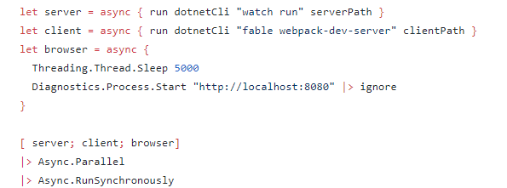
async { … }
One example:
v.

Slide 70
asyncSeq { … }
let withTime = asyncSeq {
do! Async.Sleep 1000 // non-blocking sleep
yield 1
do! Async.Sleep 1000 // non-blocking sleep
yield 2
}
F# already supports async sequences, it’s a library
I love this style of “reactive” code.
“asynchronous pull” (AsyncSeq) v. “synchronous push” (IObservable)
No inversion of control, you think in a “forward” way
Makes a lovely compositional animation language
let intervalMs (periodMs:int) = asyncSeq {
yield DateTime.UtcNow
while true do
do! Async.Sleep periodMs
yield DateTime.UtcNow
}
v.
https://fsprojects.github.io/FSharp.Control.AsyncSeq/

Slide 71
asyncMaybe { … }
1. OK, this implements a C# framework abstraction
[<DiagnosticAnalyzer(FSharpConstants.FSharpLanguageName)>]
type internal SimplifyNameDiagnosticAnalyzer() =
inherit DocumentDiagnosticAnalyzer()
static let cache = new MemoryCache()
...
override __.SupportedDiagnostics =...
override __.AnalyzeSemanticsAsync(document, cancellationToken) =
asyncMaybe {
do! Option.guard Settings.CodeFixes.SimplifyName
do Trace.TraceInformation(…)
do! Async.Sleep InitialDelay |> liftAsync
let! _parsingOptions, projectOptions = ...
let! textVersion = ...
let key = document.Id.ToString()
match cache.Get(key) with
...
}
|> Async.map (Option.defaultValue ImmutableArray.Empty)
|> StartAsyncAsTask cancellationToken
I absolutely love the uses of this CE in the FSharp.Editor implementation by Vasily Kirichenko
This helps makes some of the clearest, most declarative, most robust editor implementation code I know
2. YES! Caching. Good caching.
Small cost to pay, indicates no chance of failure here
4. YES! clear failure/stop points
v.
3. YES! Cancellation supported (but I don’t need to think about it beyond this)

Slide 72
In Closing

Slide 73
I love…
Please, implement .ToString() and DebuggerDisplay to aid debugging
Code that can be debugged
Code that is commented
Code that is tested
Code that is performant
Code that is under CI
Code that is readable
Please, use good variable names
Please, use good method names and seek good stack traces
Please, comment your code well

Slide 74
Summary - F# is full of delightful moments - Constructs need to be used with moderation - Functional, Object and other features can be misused - Please share experiences and help improve coding standards Thanks!

Slide 75
Thanks! Questions?

Slide 76
Historical archaeology: Some code that inspired early F# - Forte FL – An Intel internal toolchain for formal verification using a functional language. Reinforced how powerful functional programming is for practical symbolic manipulation - HOL Lite – A brilliant development of a theorem prover using Caml Light. Taught me the immense practical power of the core ML language. - SPiM – Stochastic Pi Machine, plus user interface elements. Beautiful, simple core, - Static Driver Verifier – verification toolchain for Windows drivers. Taught me many good things including how bad some FP-only features can be in practice (e.g. unencapsulated mutable records)

Slide 77
The Puzzle
In 2014, we now do open engineering on to all of F# and Visual F# Tools
Still packaged in Visual Studio as an enterprise-supported product.
Xamarin, Debian, OSX, WebSharper, FunScript, Alea, …
Language
Openness
Community
Ecosystem
IDE Tools
Cross-platform
The
F# Software Foundation as a voice for F#
fsharp.org
XamarinStudio, Emacs, Vim,
FSharp.Compiler.Service
Visual F# Power Tools …
Embrace an open ecosystem of F# libraries, tools and type-providers

Slide 78
Agents Good, Agents Bad Agents are an expensive sledge-hammer that give you a concurrent queue with multiple writers and a single async reader Queues are mutable state that are often hard to reason about. Only use when necessary

Slide 79
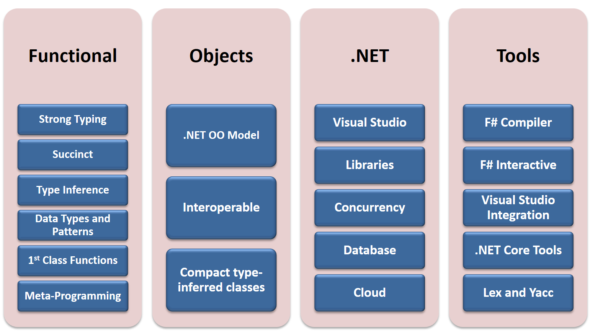

Slide 80
Functional
 | Expression-oriented | No null | Multiple Args = Tuples | Closure and Capture | First-class Values | Currying | HM Type Inference
void (unit) | ✓ | ✓ | ✓ | ✓ | ✓ | ✓ | ✓
Object Types | ✓ | ✓ | ✓ | ✓ | ✓ | ✓ | ✓
Subtyping | ✓ | ✓ | ✓ | ✓ | ✓ | ✓ | ✓
Dot-notation | ✓ | ✓ | ✓ | ✓ | ✓ | ✓ | ¾
Inheritance | ✓ | ✓ | ✓ | ✓ | ✓ | ✓ | ¾
Method Overloding | ✓ | ✓ | ✓ | ✓ | ¾ | ✗ | ¾
Objects
Relatively Graceful Degradation
(some type annotations needed)
Relatively Graceful Degradation
(some type annotations needed)
Some combinations outlawed for sanity

Slide 81
Then (2003) In the 1990s functional languages were historically anti-OO Even today any mention of objects in some Haskell circles gives people an “urrgghhh…” reaction. Modern Compiler Implementation with Standard ML - Chapter 14, Object Oriented Programming object – to express a dislike or distaste for something

Slide 82
Code I love: Functional computation of encapsulated tables and summaries
type MyAlgorithm(inputs) =
let part1 = ...
let part2Helper arg1 arg2 = ...
let part2 = ...
let results = ...
let result1, result2 = ...
member __.Result1 = result1
member __.Result2 = result2
member __.Lookup item = results.[item]

